Slide 1
Rocks and Minerals
Mr. Johnson
Tutt Middle ~ 6th Grade

Slide 2
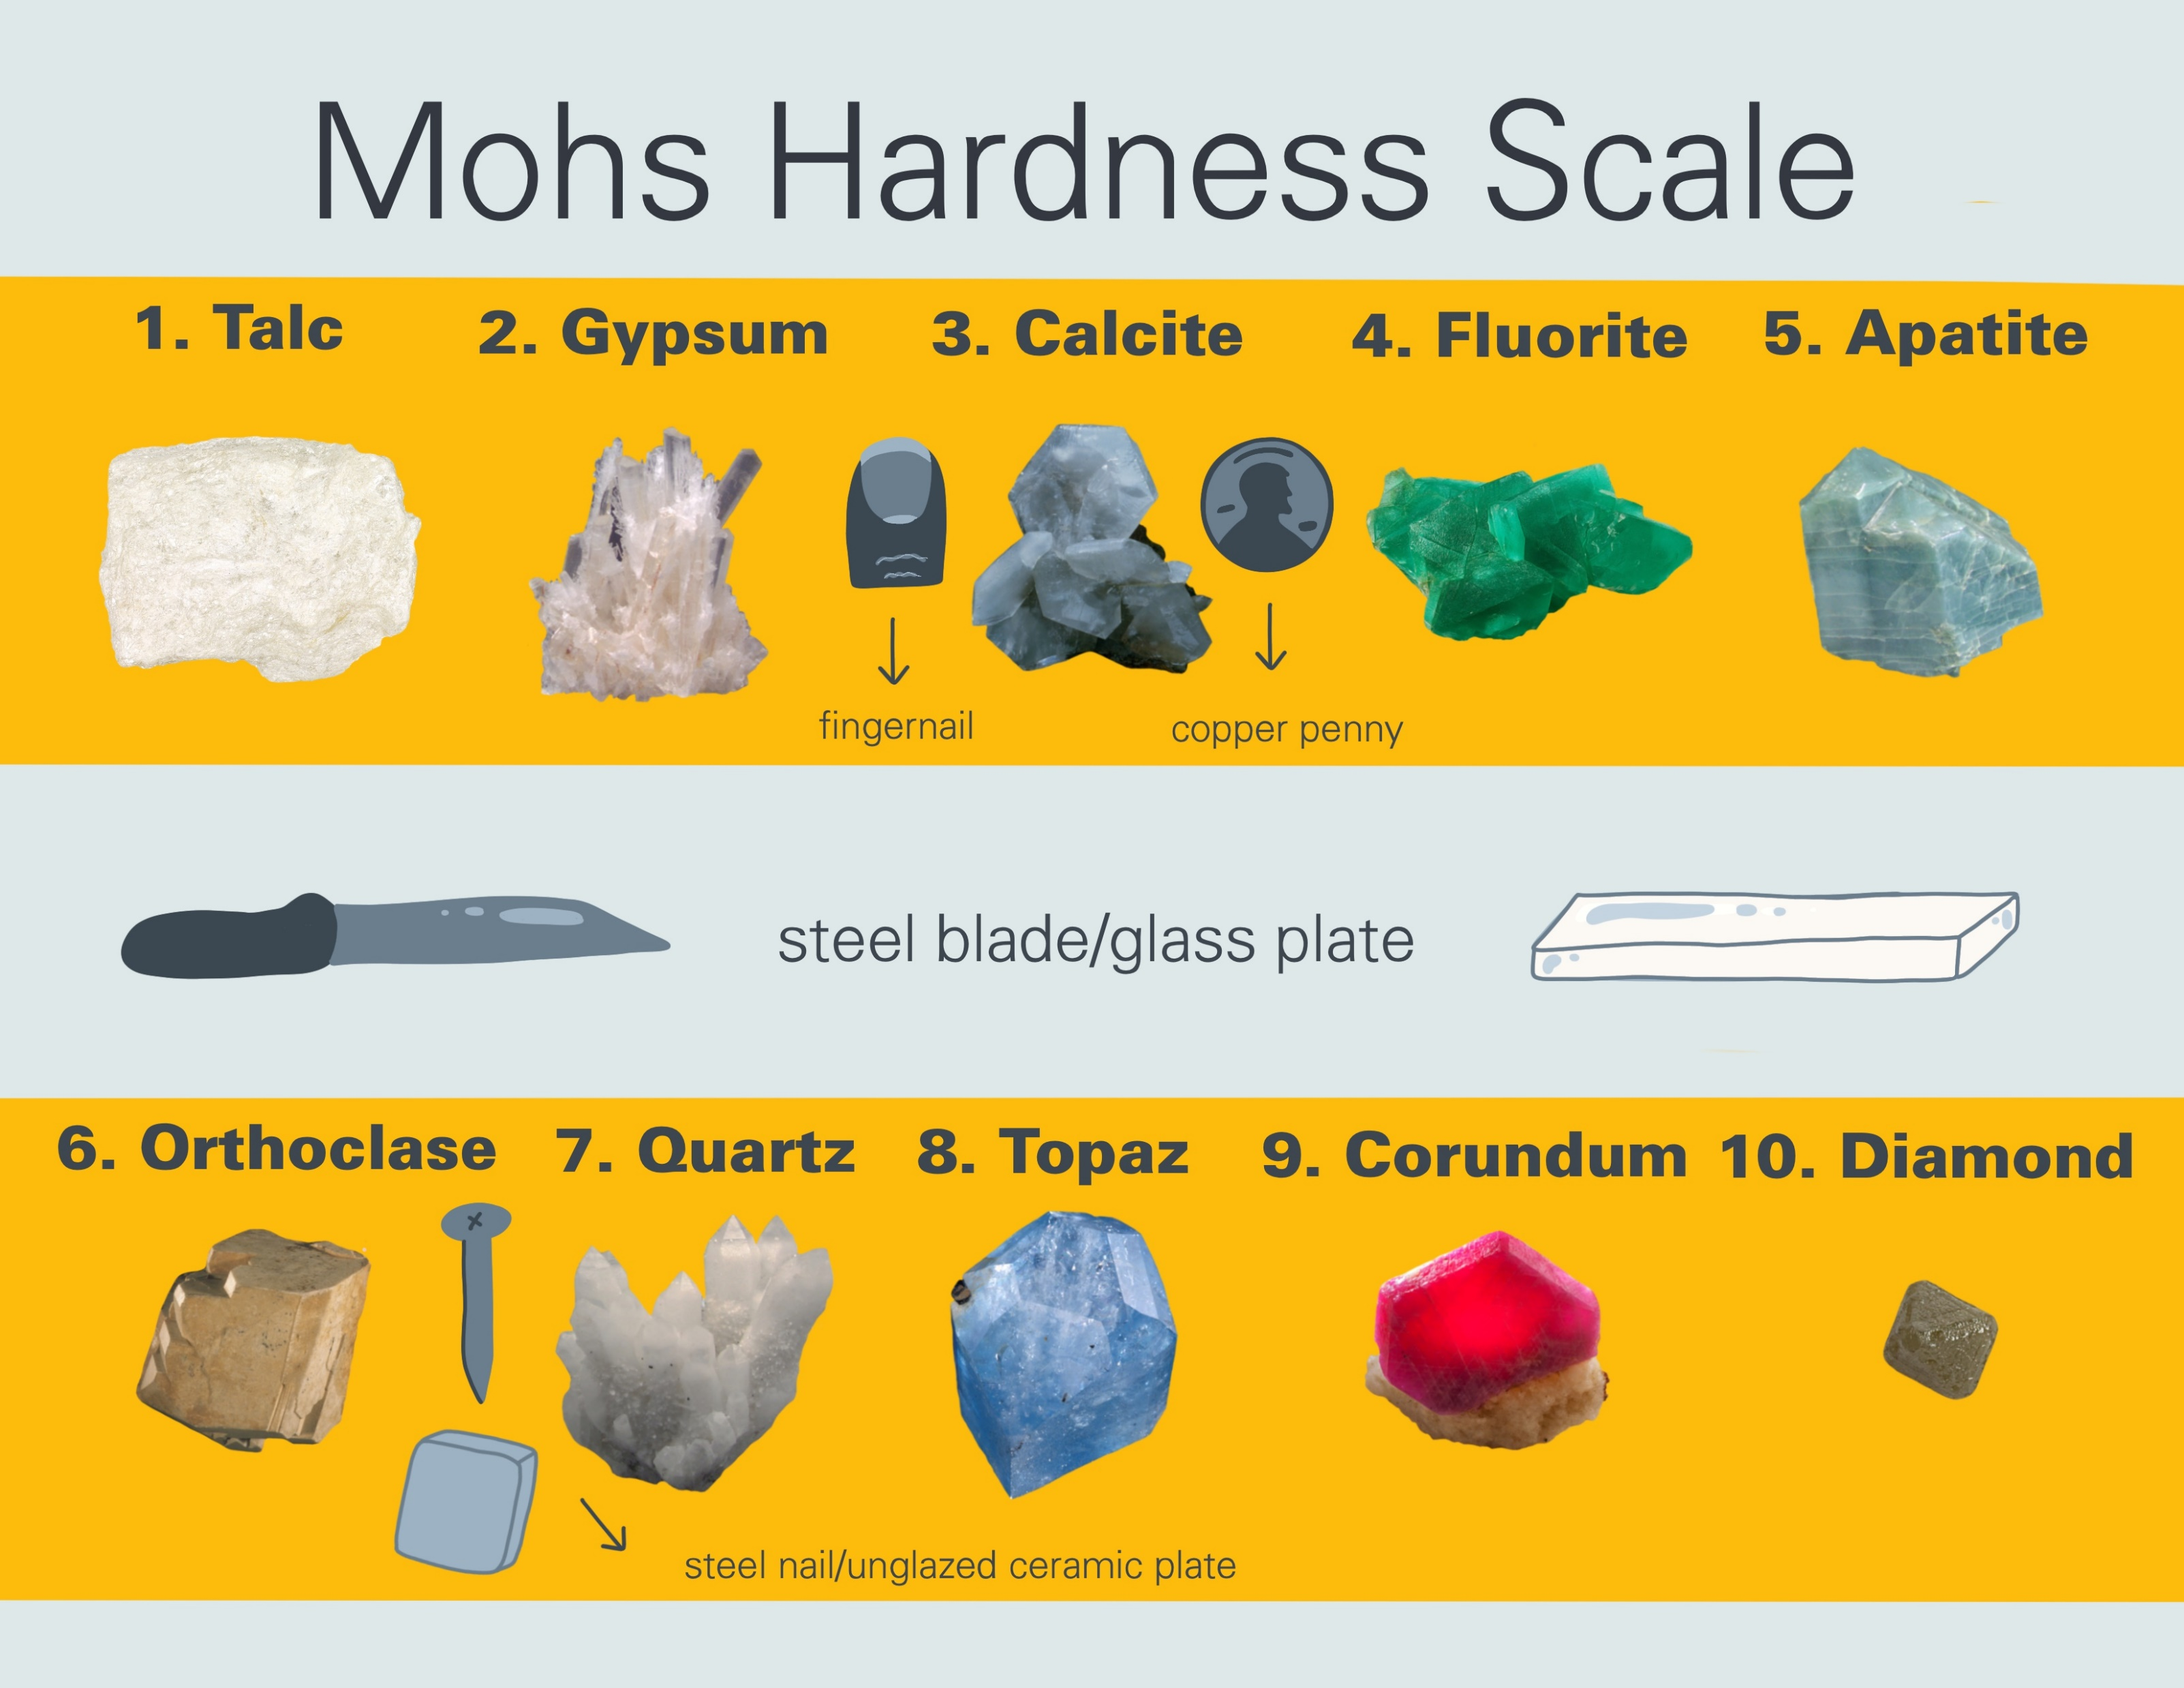
Mohs Hardness Scale
Type all 10 Minerals
1. Talc
2.Gypsum
3.
4.
5.
6.
7.
8.
9.
10. Diamond

Slide 3
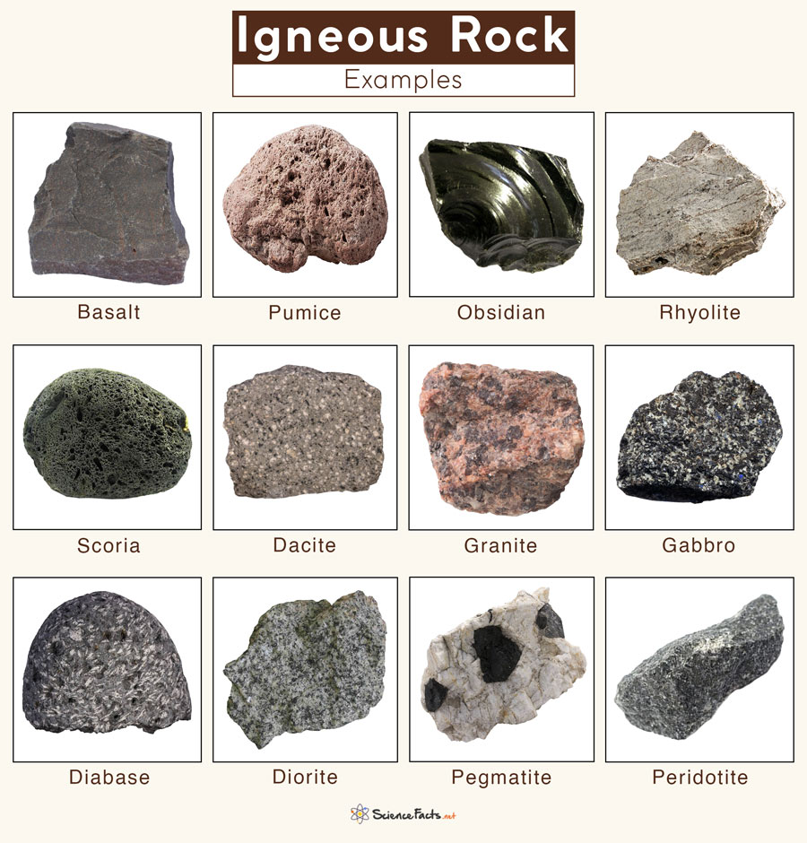
Igneous Rocks

Slide 4
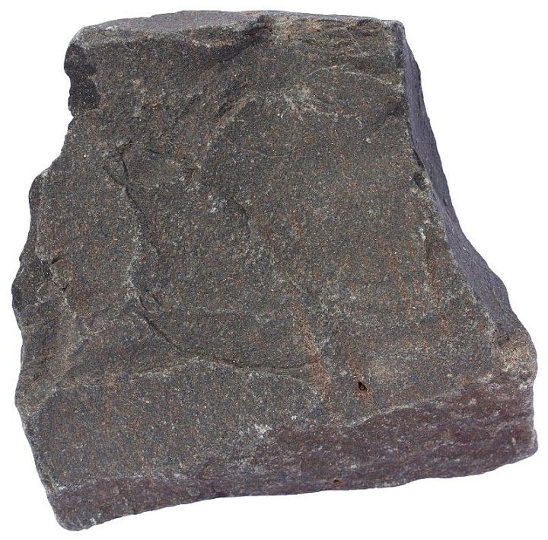
Basalt
Igneous Rock
(Oceanic crust)
Answer

Slide 5
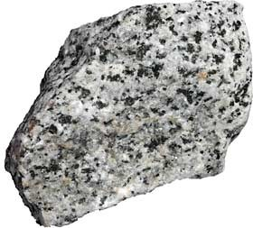
Granite
Igneous Rock
(most common continental crust)

Slide 6
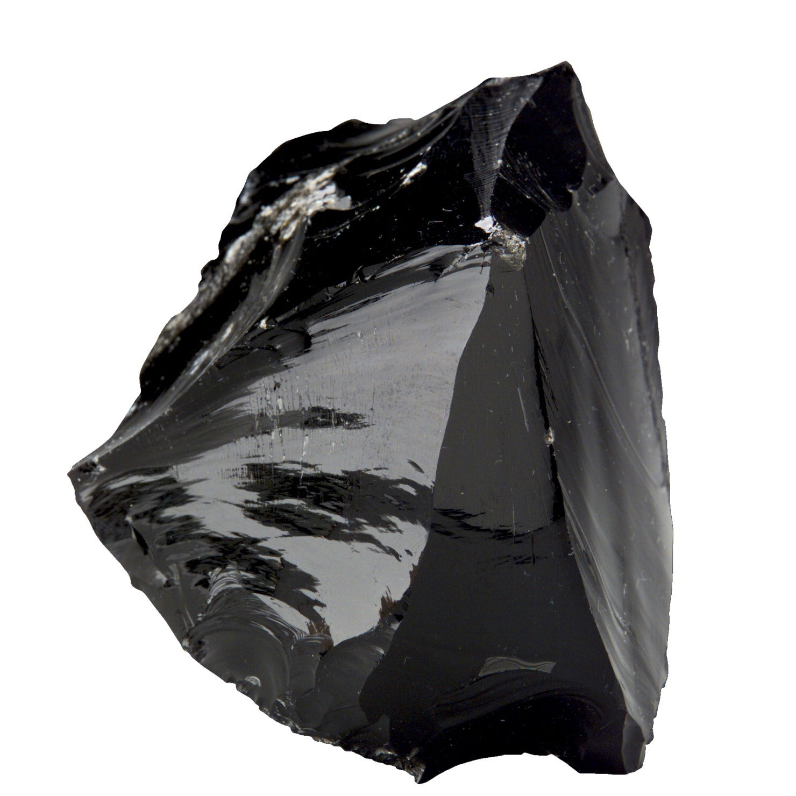
Obsidian
Igneous Rock
(spear heads)

Slide 7
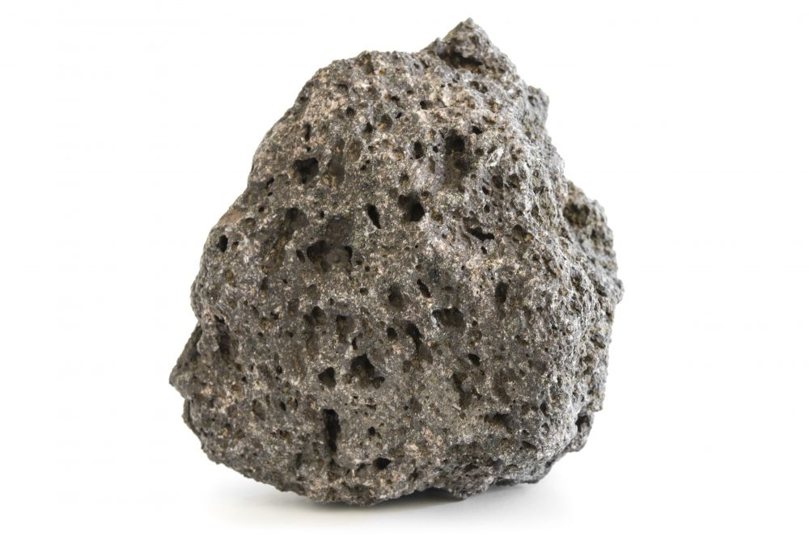
Pumice
Igneous Rock
(can float)

Slide 8
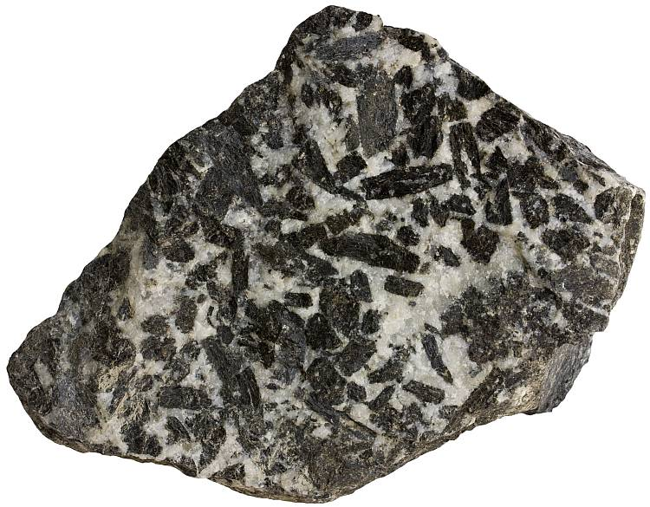
Gabbro
Igneous Rock
(Oceanic crust)

Slide 9
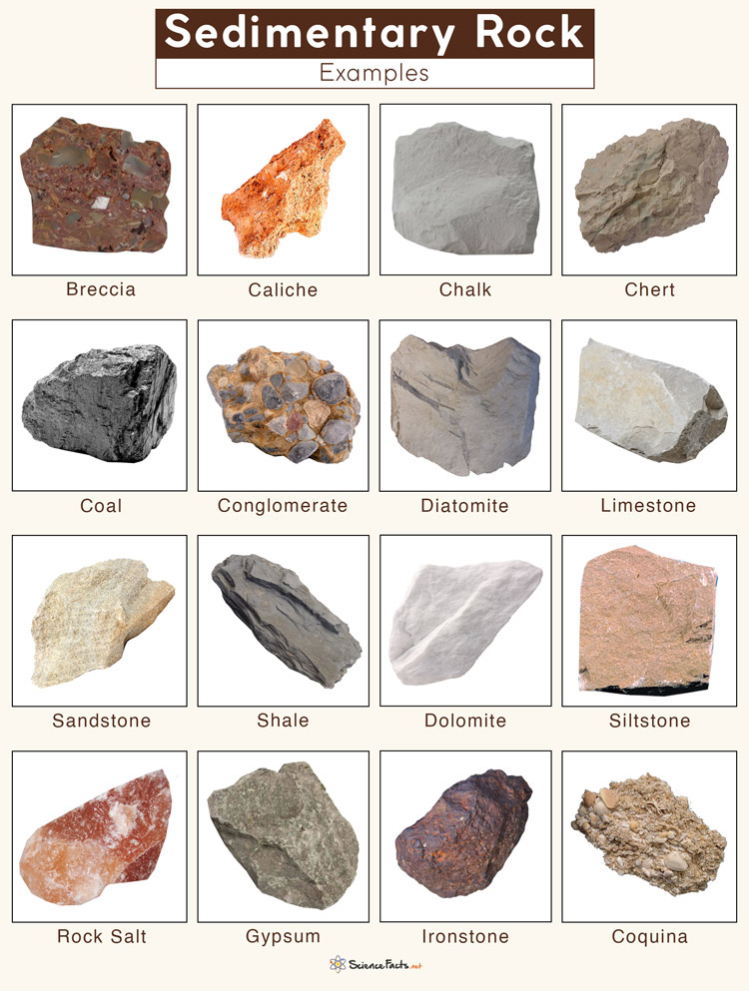
Sedimentary Rock

Slide 10
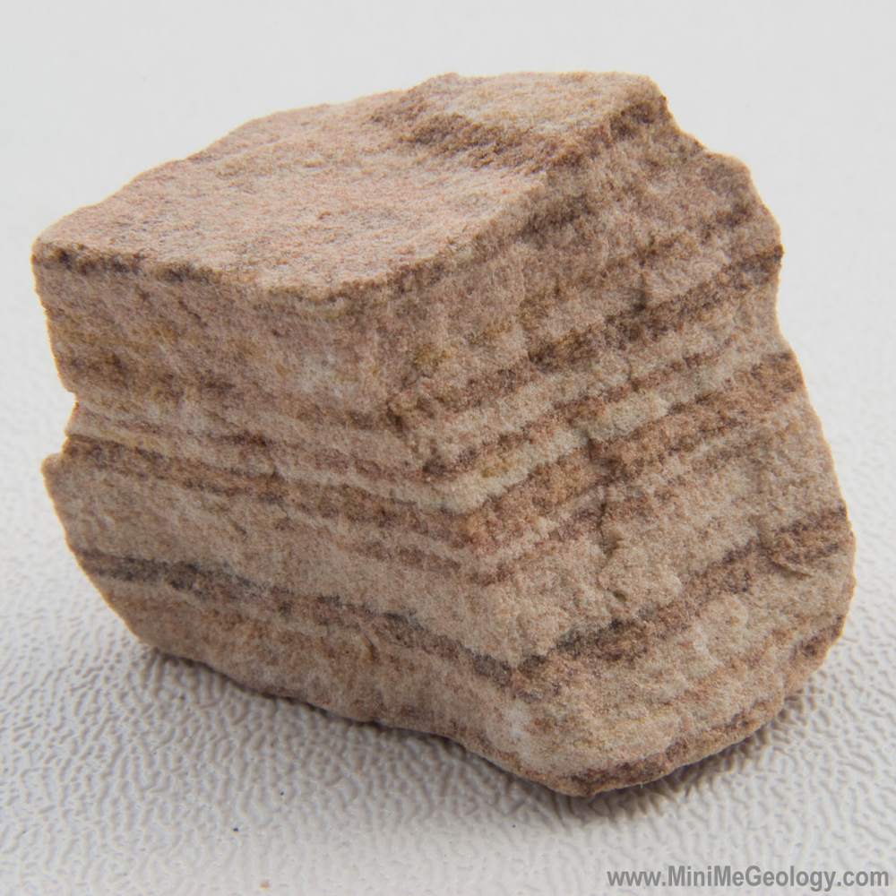
Sandstone
Sedimentary Rock

Slide 11
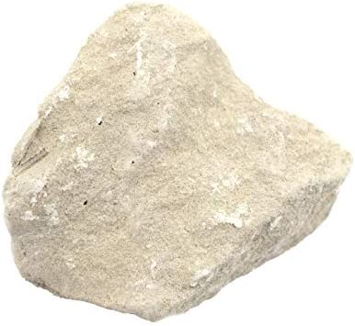
Limestone
Sedimentary Rock

Slide 12
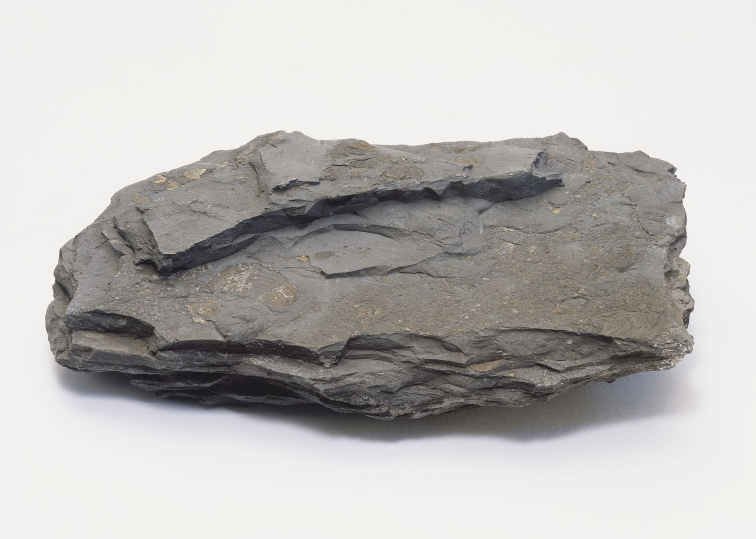
Shale
Sedimentary Rock

Slide 13
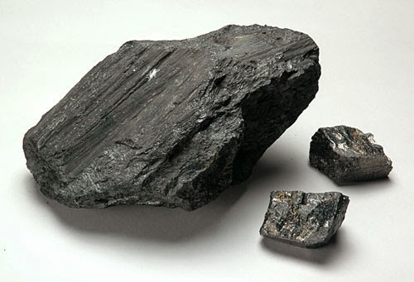
Coal
Sedimentary Rock

Slide 14
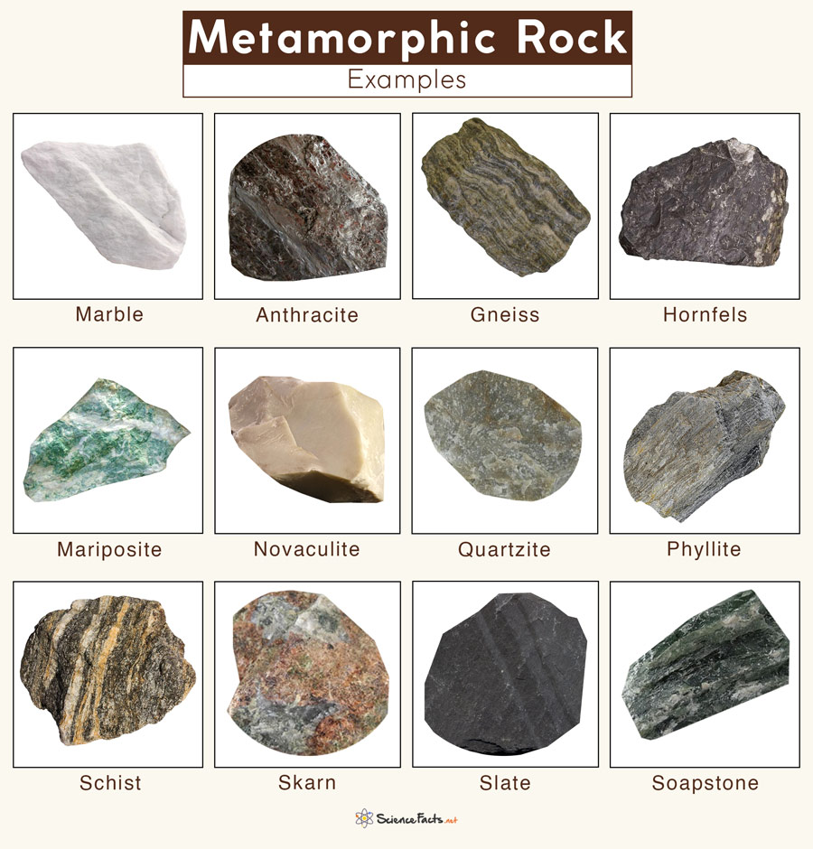
Metamorphic Rock

Slide 15
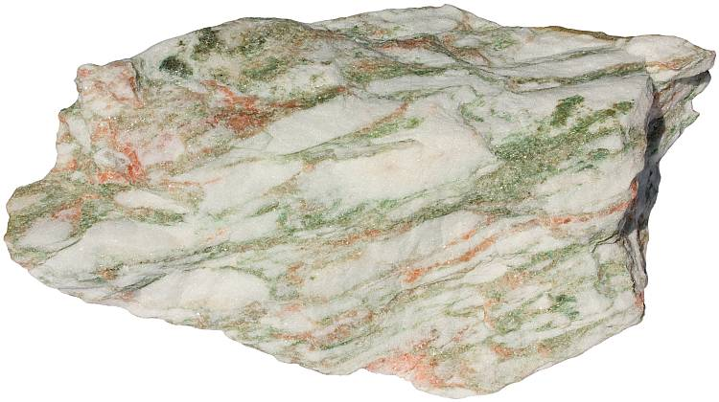
Marble
Metamorphic Rock

Slide 16
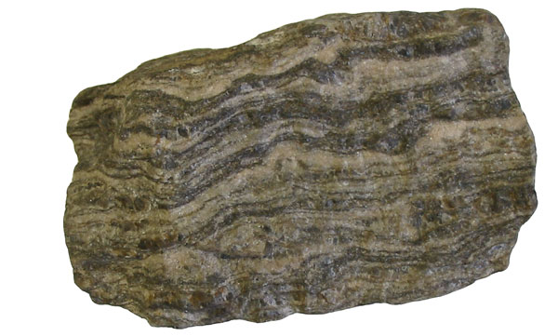
Gneiss
Metamorphic Rock

Slide 17
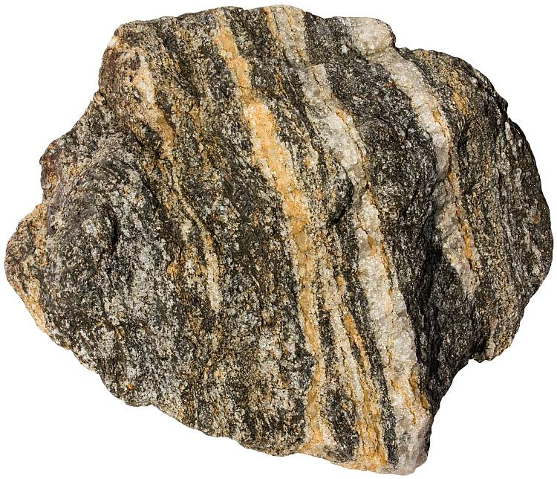
Schist
Metamorphic Rock

Slide 18
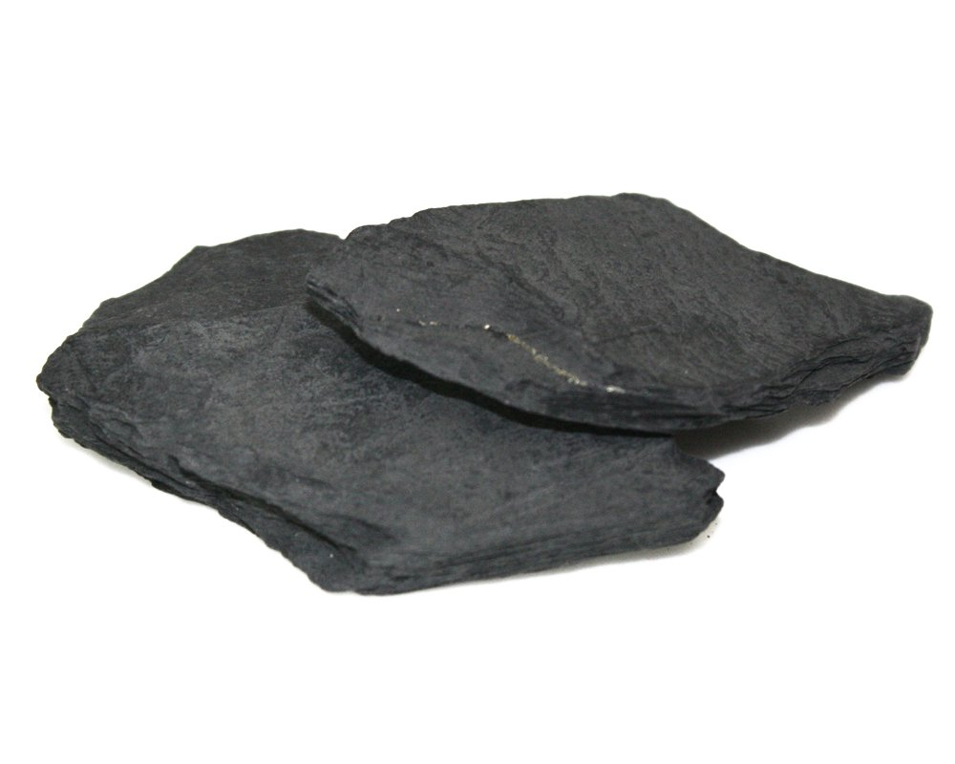
Slate
Metamorphic Rock

Slide 19
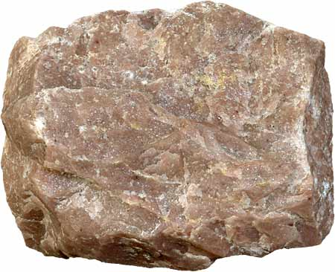
Quartzite
Metamorphic Rock

